Slide 1
FRC | Science Fair | Vacuum Robot
段佑霖

Slide 2





FRC Magnolia Regional (Mississippi)
3/18 - 3/21
Mini Autopilot Panel
6/6
Started using API keys to grab standard information about teams, as well as more information and input sections
Built a mini autopilot to control the autopilot in my flight simulator.
Created the first version of my Pit Collect website and put it to use.
Built a mini autopilot to control the autopilot in my flight simulator.
FRC Championship
(Houston)
4/29 - 5/1
Vacuum Robot & Science Fair
7/1 - Present
Brief Overview of Events

Slide 3








FRC

Slide 4

2026 Robot

Slide 5



Contributions
Loss focus, too many points in one page, which is the key point you want to show?
Suggest: separate it
Example: Distribution (1/3)
Show your coding
Created a type of scouting website called Pit Collect, which our team used to analyze the hardware and basic strategy of other teams
  Can be used to figure out how to play against them
  Determine how to cooperate with them when they are on the same side as us
  Helped to build an advanced knowledge and understanding of HTML, JS, and CSS through the help of vibe coding and my own code.
Helped solder part of the wiring for the robot
  Massively developed my soldering skills
  Paved the way for future projects
Worked on object detection models for the 2026 robot
  Helped to map out game pieces and compile into an object detection model for our robot
  Taught me the basics of object detection and object detection software, such as Roboflow
Show the software picture, to catch the eyes, to avoid from missing of your accomplishment (accuracy data before and after)

Slide 6

FRC Magnolia Regional
3/18 - 3/21

Slide 7


Results
Final Score:
188:288
12th out of 46 teams
Match record of 6-3-0.
Got into the semifinals of the playoff matches
Won the Impact Award
  took us to the FRC Championship in Houston
My Pit Collect Website was used to track the data of over 40 teams.
Impact award picture
Reason reviewing of final score is the main content interested by professor to show your potential of continuously growing in future

Slide 8
Struggles/Problems
QR Code too large
Burned Wires
To transfer data from the device the scouting was done on to the device used to compile all the results, we decided to use a qr code to transfer all the values
In the early stages of development, the QR code was too large, resulting in the scanner not being able to pick up the QR code
Solution:
When I was soldering wires, I sometimes used to accidentally burn the plastic/insulation of the wire and wire connectors, rendering the wires useless.
The soldering tin would not melt properly, and so I would keep the soldering iron on the component for a long time.
Solution:

Slide 9

QR Code Fix
To solve the issue of my QR code being too large, I utilized 4 main methods:
Setting Visual Dimension Limits
  Set the QR code size to 256 by 256 px
    Ensures the image size will not change
LZ-string Compression
  Before any of the qr codes are generated, all the TSV(tab separated values) are compressed into Base64 format
    E.g. A -> 000000, B -> 000001…
Character Sanitization
  Newlines and tabs are deleted from text inputs to save space
Doesn’t this make the file size larger?
It does, but LZ string compression looks for recurring patterns and creates a dictionary for where the values should go
Back:

Slide 10
Soldering Skills Improvement
Since I kept the soldering iron on the component for too long, it caused the plastic surrounding the metal contacts to melt. This results in the component becoming unusable, which wastes time and resources.
Plug a spare connector in
  By plugging in a spare connector, it acts as a heat sink. The extra metal contacts mean that more heat is required to raise the temperature of the component, allowing me to keep the soldering iron on for longer.
Pre-tin both the connector and the wire
  I used to only pre-tin the wire, which meant that there will be poor heat transfer
  By tinning the connector too, the metal heats up way quicker
Heat shrink wrap
XT-60 Connectors
Back:

Slide 11


FRC Houston Championships
4/29 - 5/1

Slide 12




Results
9 divisions in total
49th out of 75 teams in the Daly Division
My Pit collect website was used to scout over 70 international teams
Win loss record of 4-6-0
Added major features to my Pit Collect website
  API key grabbing from the Blue Alliance to display basic information about a team.
  Allowed for teams to draw out multiple autonomous strategies

Slide 13


Struggles/Problems
Robot wiring failures during match
  During a lot of the matches, our robot could not move due to electrical wiring mistakes and zeroing issues due to human error
  Time constraints
Autonomous path drawing is laggy
  To lower the QR code size, I decided to lower the amount of points(x,y) that will be plotted when you drew on the field.
  This made the line drawing inaccurate and laggy, which meant we were compromising our data for file size
  = lossy compression
Although I was not in the fixing team, this experience has taught me that even under pressure, you cannot skip steps in the standard procedure, and must follow the checklist as intended.
To fix the Autonomous path drawings, I implemented the following methods:
  Used addPoint with distance filtering (<2% threshold) to drop micro-movements and keep drawing smooth and responsive.
  Applied the simplifyPath (Ramer–Douglas–Peucker) algorithm only during QR generation to remove redundant points on straight lines without affecting live drawing accuracy.
  Saved each path as their own individual path rather than one large Autonomous QR code.
Pictures

Slide 14


Johnson Space Center

Slide 15



Saturn V Rocket
When I visited the Johnson Space Center in Houston, the thing that stood out to me the most was the Saturn V Rocket. When I approached it, I was in awe of its massive size and complex engineering.
Realization: True engineering requires everything to be done step by step, and everything has to be done to perfection.
Please consider to show what actual action you did after this experience?
Like what article you survey in further?
To show your true motivation instead of only thinking inside brain
Otherwise, this seems like a trip record, nothing helpful for your goal of 特殊選才

Slide 16


Space Shuttle Carrier
This modified Boeing 747 carrying the shuttle orbiter shows structural load distribution, as well as the aerodynamic modifications required for a B747 to transport the Space Shuttle Orbiter.
I examined the old flight controls and avionics, where I noticed that it still resembles modern flight displays today.
Where? Cycle it to prove your understanding
what article you survey in further? This is the most important thing

Slide 17

Inspiration for Future Career
Johnson Space Center Reflections
Further reinforced my goal to pursue EE/Mechanical Engineering/ Communications to become a pilot with a deep technical foundation in flight control systems
Seeing how mechanical, electrical, and control systems come together in Aerospace inspired me to build my own physical Flight Simulator Autopilot Panel. The large aircrafts and spacecrafts further inspired me to pursue the field of STEAM based majors.

Slide 18
Flight Simulator Autopilot

Slide 19


Overview & Functionality
Software and Communication
AP On/OFF
Heading Control/ VS Select
Physical autopilot hardware built to control heading, vertical speed, and navigation modes in flight simulation.
Integrates real-time rotary encoder inputs and LCD outputs to display live in-game flight data.
Altitude Controls
Navigation Modes
Vertical Speed
Display Modes
Using Mobiflight, I created an instruction set that converts my inputs into in-game actions and also grabs live game data.

Slide 20





Hardware & Electrical
Primary Components:
Arduino Nano
6x6 mm buttons x11
Rotary Encoder w/ Push Button x2
LCD with I2C backpack
Jumper Wires
_____________________________________________
Daisy chained the Ground wire of each
component to save space
Biggest Problem:
  The soldering iron would often burn the 3d printed plastic, so I had to solder each component quickly before it melts the plastic
Example of daisy-chaining wires

Slide 21
Main Takeaways From this Project
My biggest takeaway from this project is the concept of daisy chaining wires. Instead of running individual, redundant ground wires to every single component, daisy chaining made the circuit design more efficient.
  Impact: Reduced cable clutter, minimized signal clutter, and reduced the risk of short circuits.
Overcoming burnt insulation from my FRC soldering experiences taught me proper heat dissipation techniques and soldering techniques.
  Learned to use spare connectors/conductive parts as heat sinks
  Pre-tin both the wires and metal contacts
  Use flux
Suggest to avoid from full text in page
Can put in one picture of soldering

Slide 22


AI Vacuum Robot: Overview & Current Progress

Slide 23
About
This project combines everything I have learned over the past few years about electronics, mechanical design, programming, and communications into one self-directed build. Unlike FRC, where I worked within a team and an existing robot platform, this vacuum robot is mine from spec to chassis to code: I am designing the mechanics, wiring the electronics, writing the AI object-detection pipeline, and documenting the entire process publicly on Instagram.

Slide 24
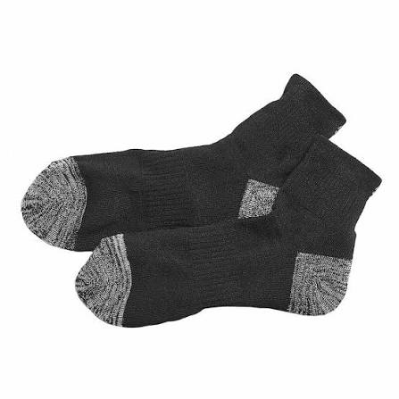
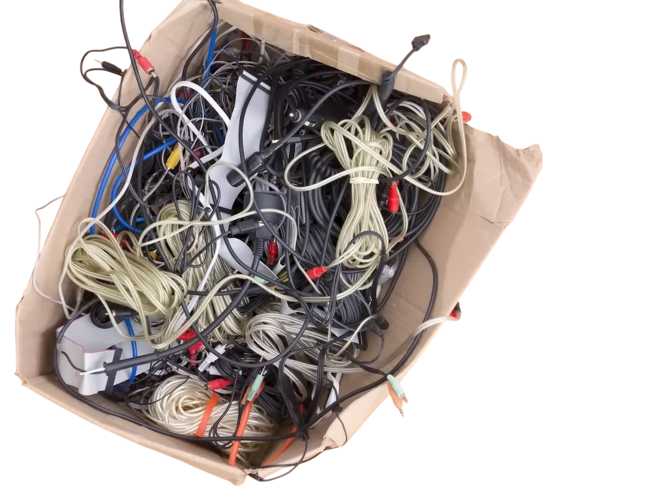
The Problem
Traditional robot vacuums rely solely on LIDAR or bump sensors. They can map walls accurately, but they blindly run over small, complex obstacles like charging cables, socks, or pet waste, causing damage to the robot or the home. A system that is only has map-based navigation has no concept of what an object actually is, only that something is or is not there.
???

Slide 25
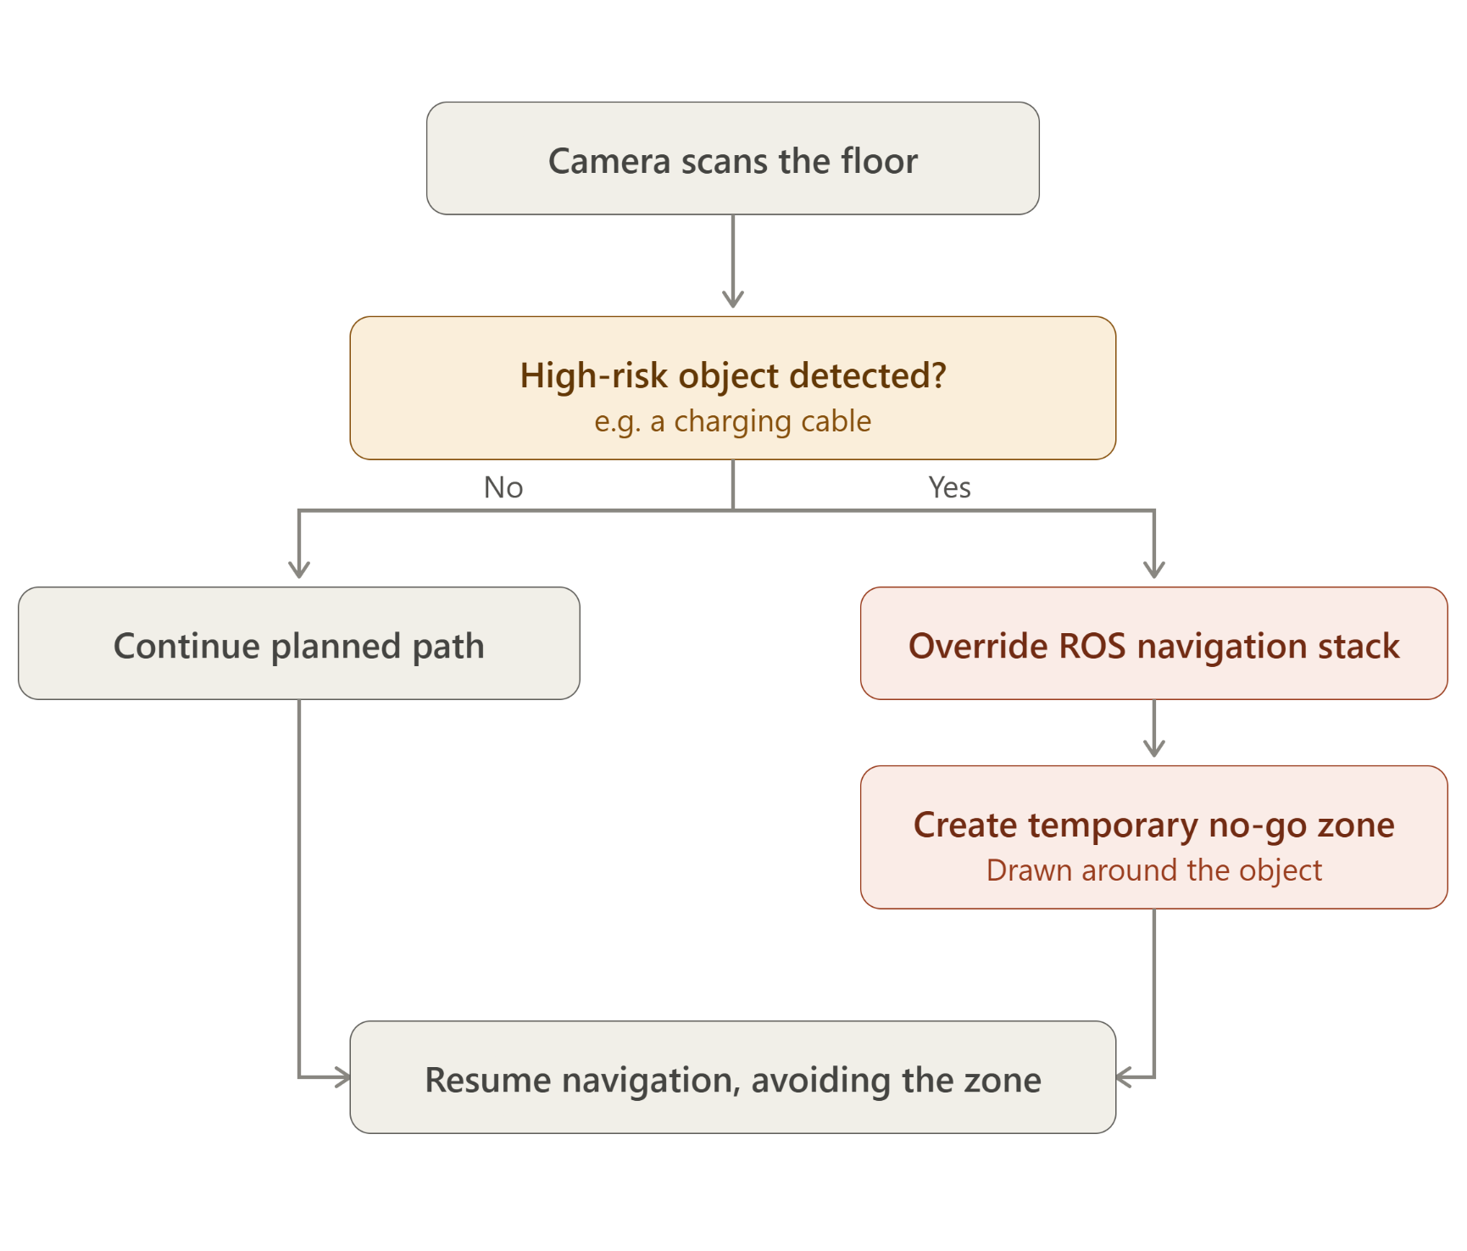
The Solution
Computer Vision Integration: Runs a lightweight TensorFlow Lite machine learning model using a front-facing webcam.
Proactive Scanning: Scans the floor area ahead of time before the robot physically enters the space.
Low-Profile Hazard Detection: Identifies small, high-risk objects (like charging cables) that standard LIDAR or physical bump sensors usually miss or only react to after impact.
ROS Override: Temporarily overrides the ROS navigation stack to draw a dynamic "no-go" zone around the detected object for real-time path planning.

Slide 26
How the Vacuum Works: Suction + Brushing
Structural diagram to illustrate your understanding of physics
Suction: A high-speed motor spins an impeller fan at roughly 30,000 RPM, creating a low-pressure zone inside the dustbin. Outside air rushes in to equalize that pressure, carrying dust and fine debris with it.
Active brushing (new): A dedicated brush motor now agitates dirt and hair directly off the floor as the primary cleaning force, with the impeller fan providing secondary suction to collect what the brush lifts, rather than relying on suction alone.
Why the change matters: Suction alone struggles with debris that is stuck to or embedded in carpet fibers. Mechanical agitation from a brush roller physically dislodges it first, which is how most commercial vacuums work, and is a lesson I learned by testing suction-only performance first.

Slide 27
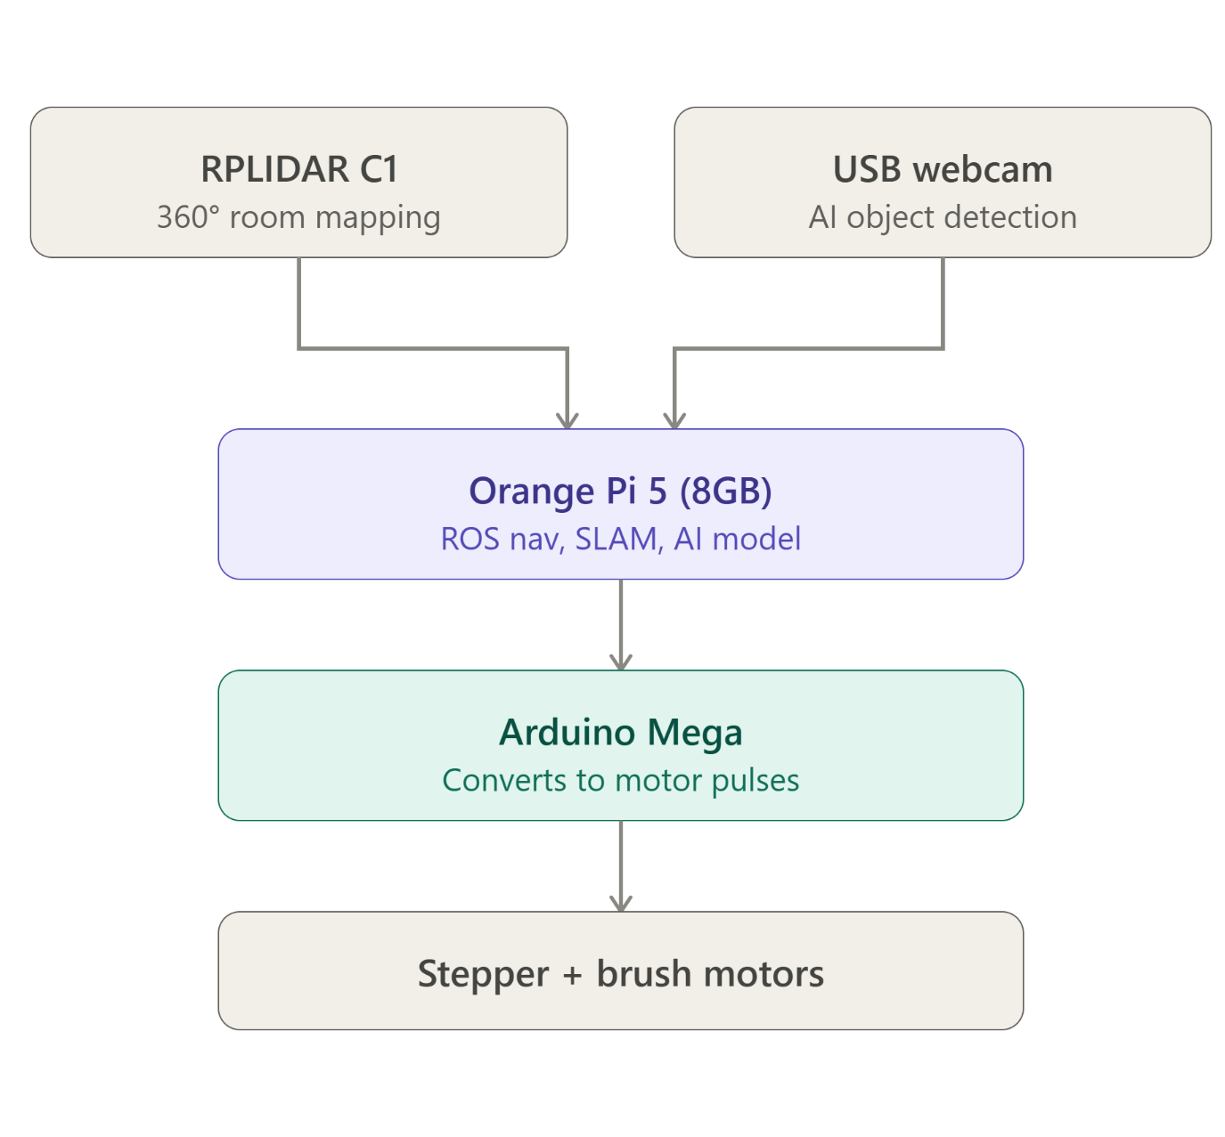
System Architecture
High-Level Brain: Orange Pi 5 (8GB)
  Runs ROS navigation and SLAM mapping
  Runs the AI object-detection model
  Upgraded from a Raspberry Pi 4 for more onboard compute headroom
Low-Level Controller: Arduino Mega
  Receives velocity and motor commands from the Orange Pi
  Converts commands into electrical pulses for the stepper and brush motors
Sensors
  RPLIDAR C1 ~ 360-degree scanning for room mapping
  Standard USB webcam ~ AI object detection (swapped from the Raspberry Pi Camera Module for easier integration with the Orange Pi)

Slide 28
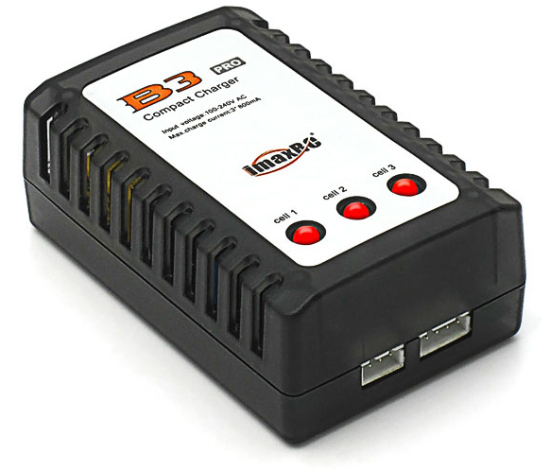
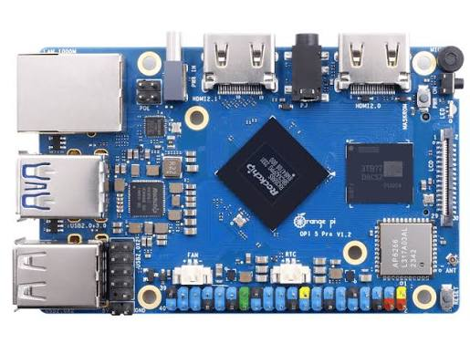
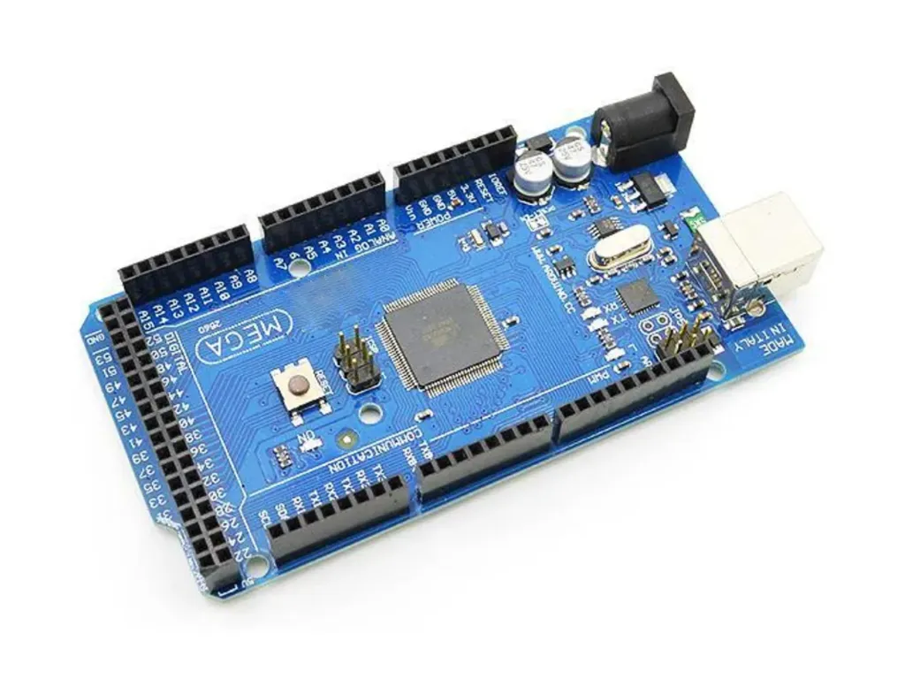
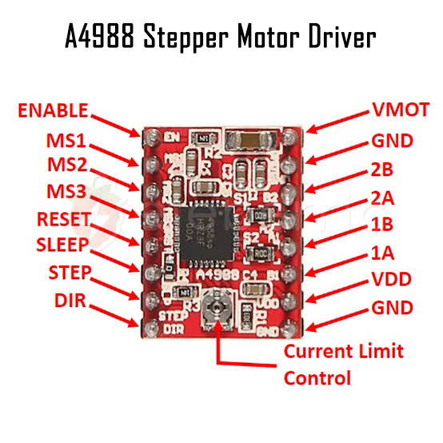
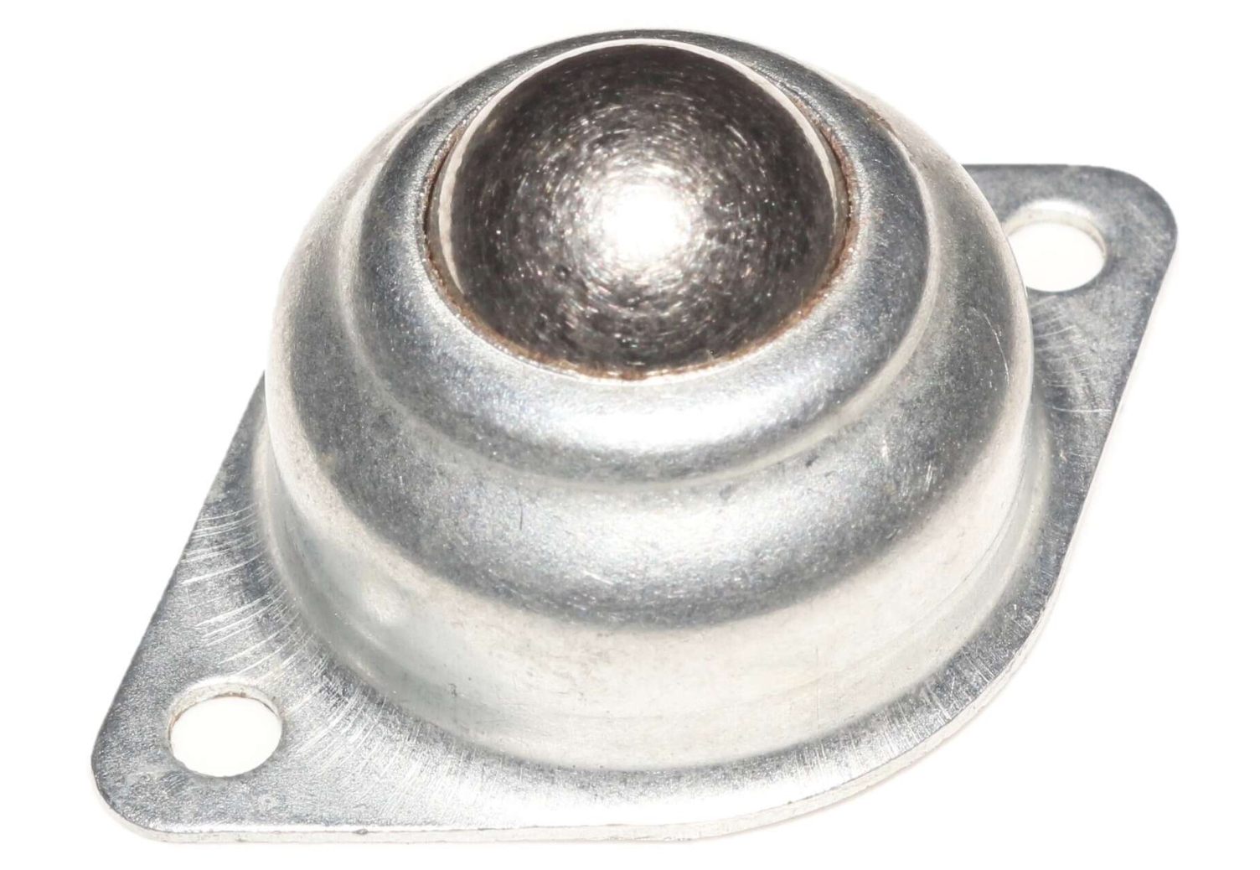
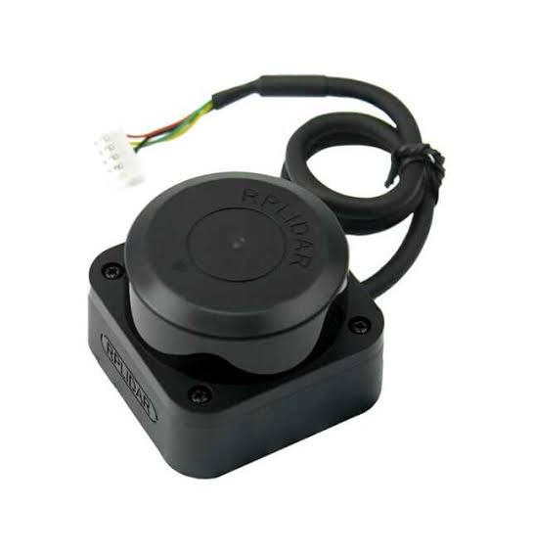
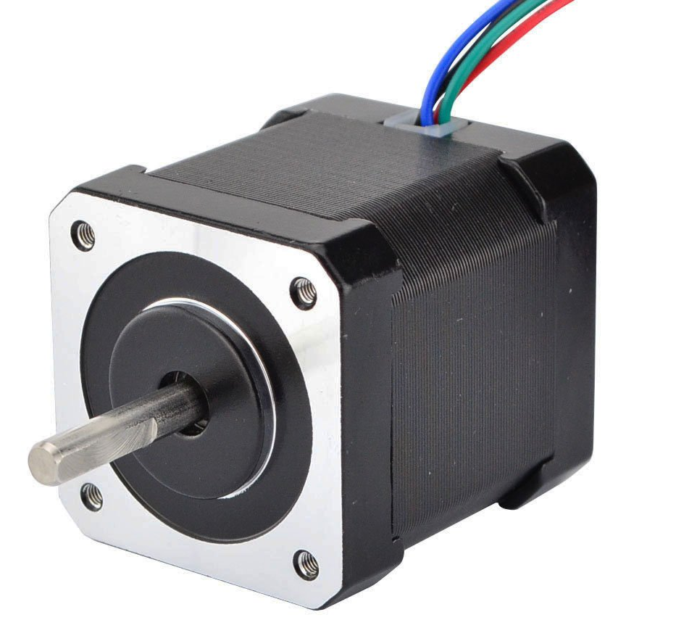
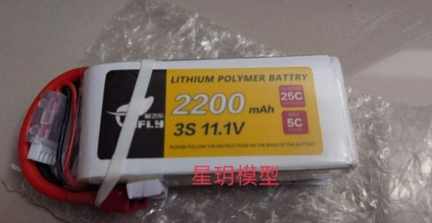
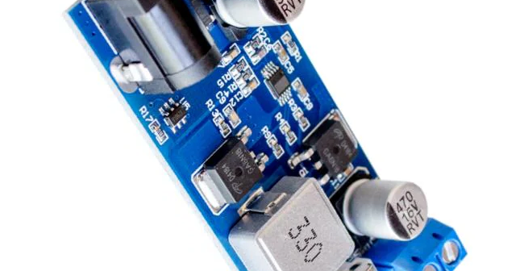
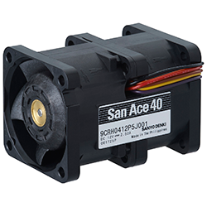
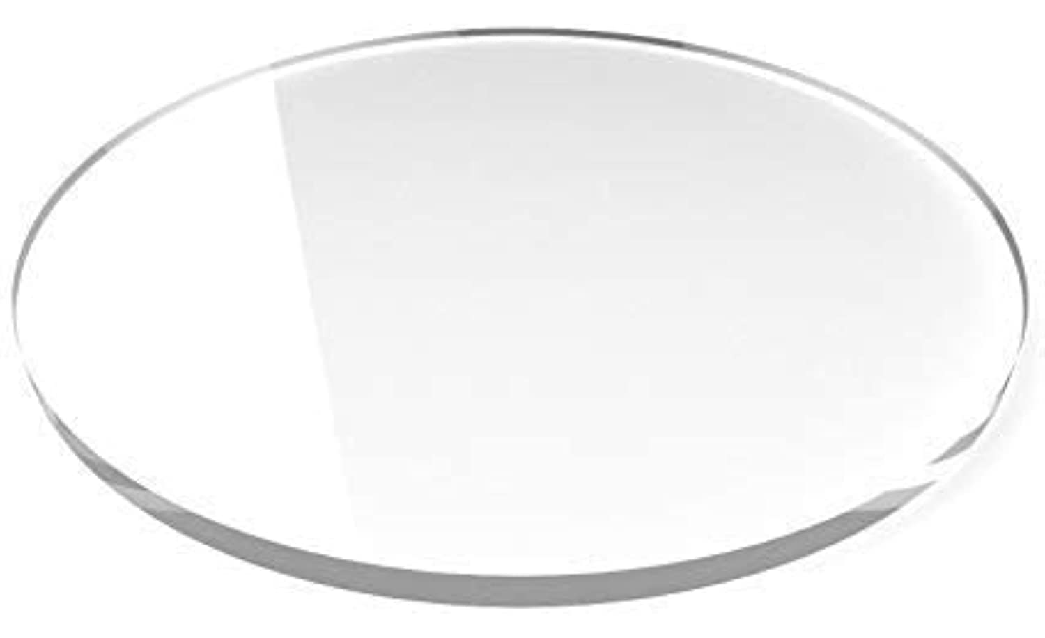
Main Components and Materials
Computing & Control: Orange Pi 5 (8GB), Arduino Mega, iMax B6 charger/balancer
Sensors: RPLIDAR C1 (360-degree), USB webcam for AI object detection
Drivetrain: 2x NEMA 17 stepper motors, A4988 stepper drivers (unchanged), rubber wheels + front caster
Cleaning System (updated): Dedicated brush motor as the primary cleaning force, plus a San Ace 40 for suction
Power: JFly 2200mAh battery, 5V/5A buck converter
Chassis: Acrylic Plate, DIY dustbin

Slide 29
Recent Fixes
Webcam screen
Design change: from suction-only to active brushing.
  Original design relied entirely on impeller suction, following the San Ace 40 fan approach from the first prototype.
  Testing showed suction alone was inconsistent on embedded dirt and hair, matching the "weak suction" risk I had already flagged as an anticipated challenge in the design phase.
  Solution: added a dedicated brush motor to physically agitate and lift debris, with suction not working alongside it rather than doing all the work alone. This mirrors how commercial vacuums combine agitation and suction.
Hardware swaps made during the build.
  Raspberry Pi 4 to Orange Pi 5 (8GB) for more processing headroom for the AI model
  Raspberry Pi Camera Module to a standard USB webcam for simpler wiring and driver support on the Orange Pi

Slide 30
Current Status
Phase: Hardware & Kinematics (Phase 1). Chassis is physically assembled and the drivetrain motors are mounted.
In progress: Wiring the electronics ~ connecting the Arduino Mega to the stepper drivers, brush motor, and power system before establishing basic remote-controlled movement.
Next steps: Bring up basic movement control, then move to Phase 2 ~ connecting the Orange Pi, configuring the ROS navigation stack, and getting the RPLIDAR C1 to generate a 2D map of a room.

Slide 31
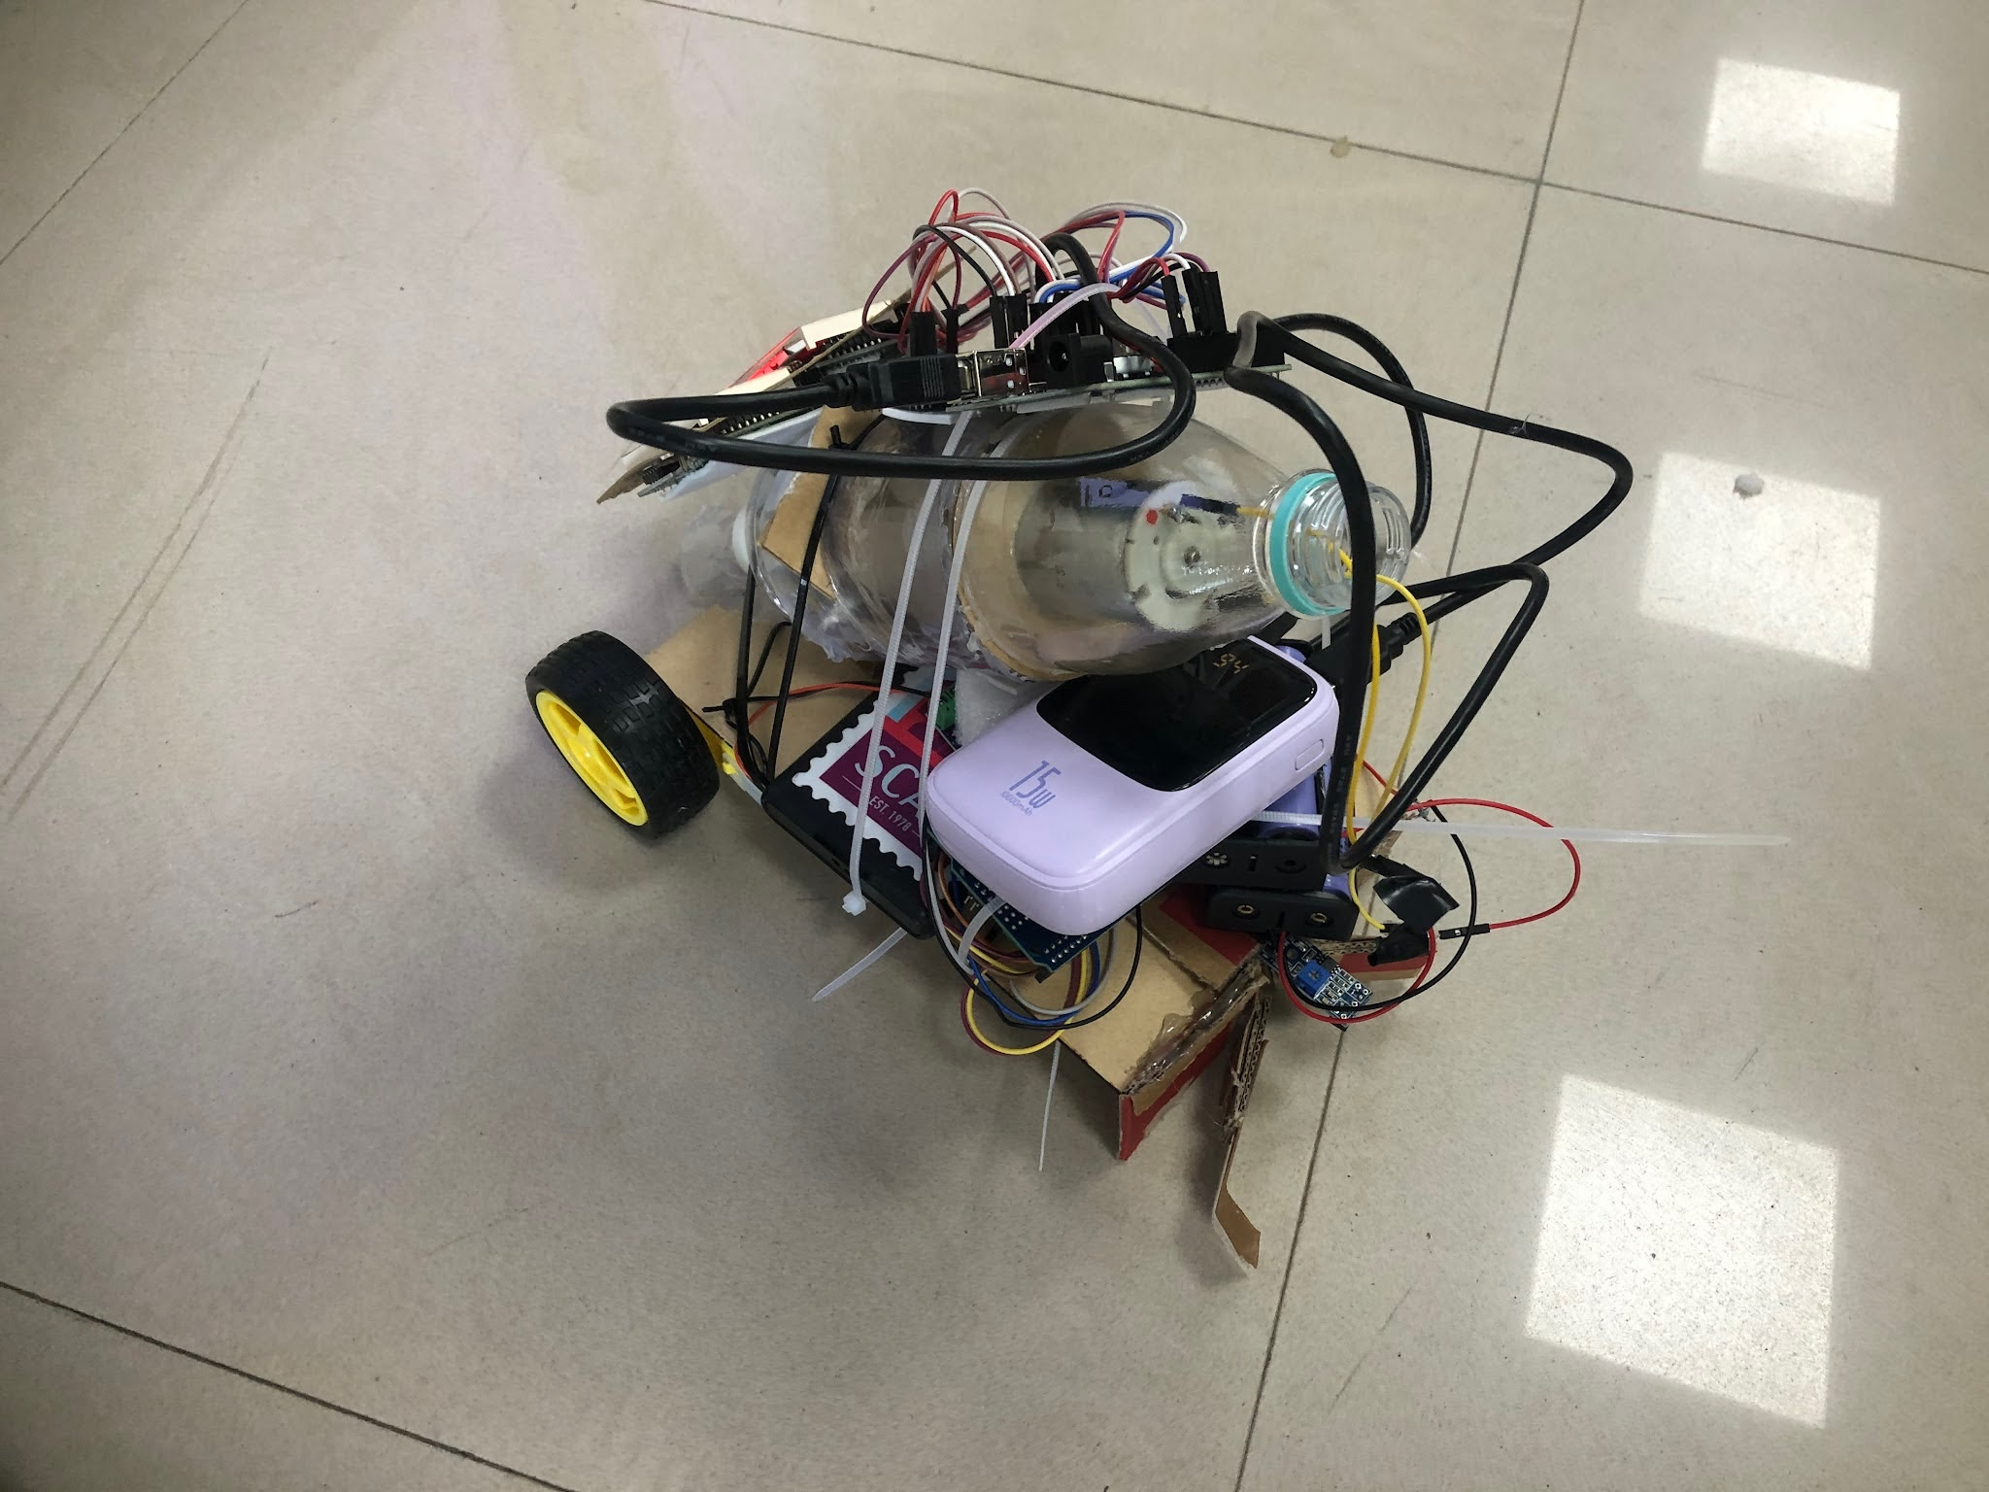
Why This Project:
<- Last year’s prototype
Is it motivation or said purpose of this project and should be put in the beginning of this chapter?
Or call it summary (end) or abstract (front)
Full-Stack Integration: Took a year-old prototype and built it out end-to-end, realizing I get a way bigger kick out of combining multiple engineering disciplines than sticking to just one area.
Mechanical: Solved the weak-suction issue by troubleshooting airflow and fixing the physical design bottlenecks.
Electrical & Firmware: Wired up an Arduino Mega to the stepper drivers to get the low-level motor control working smoothly.
AI & Software: Loaded a TensorFlow Lite vision model onto a front camera to spot small floor hazards and dynamically override the ROS nav stack with real-time "no-go" zones.
Documentation: Posted the build progress online to stay accountable and keep the momentum going.
To show your scientist spirit, how about to test the cleaning efficiency in form of percentage?
Means to say the story with data (before and after, improvement)

Slide 32


Slide 33

Instagram Page
This is my Instagram Page that I will be using to document the process of my robot.

Slide 34
Science Fair
1090 MHz ADS-B Flight Tracking & Machine Learning Trajectory Analytics

Slide 35
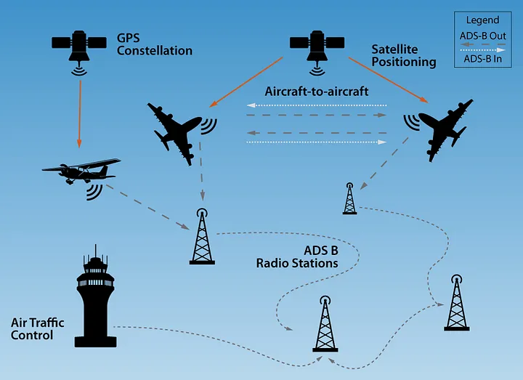
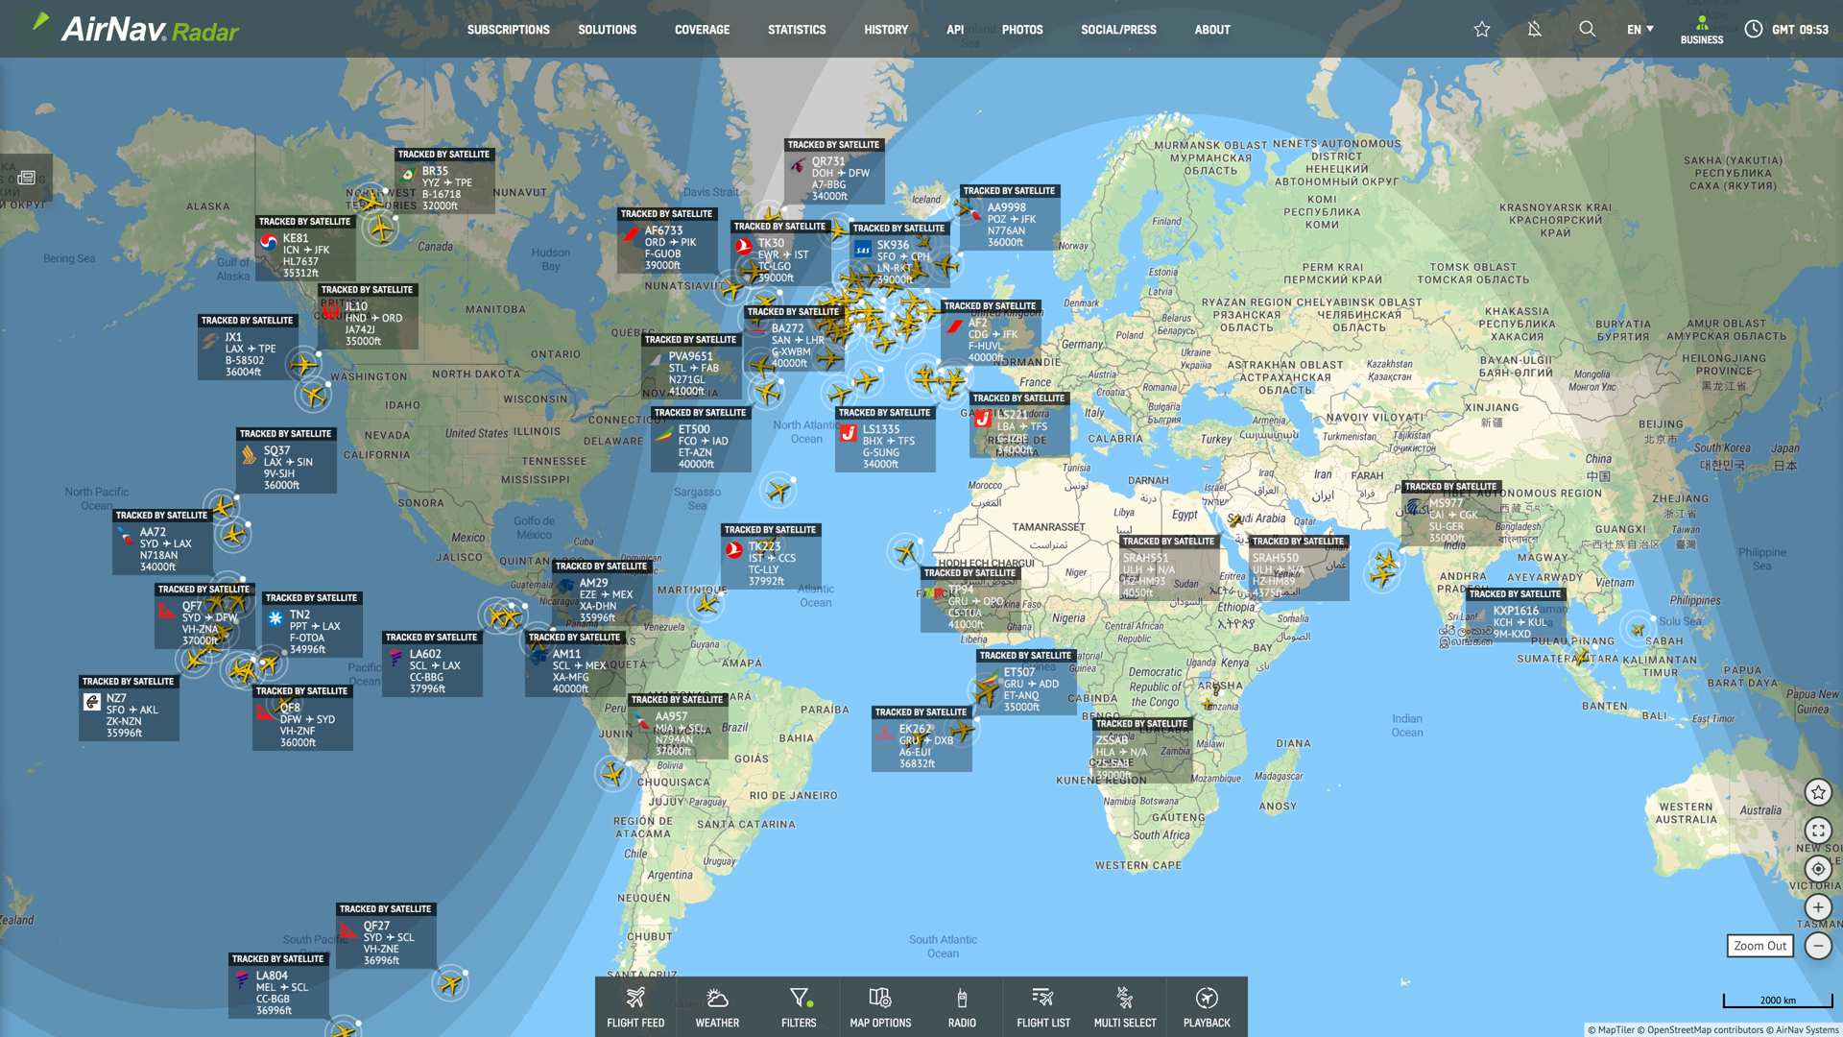
Context
Modern air traffic control relies heavily on broadcast telemetry (ADS-B). Processing raw high-frequency RF signals at the edge provides an independent, low-latency telemetry data source without relying on third-party commercial APIs.

Slide 36
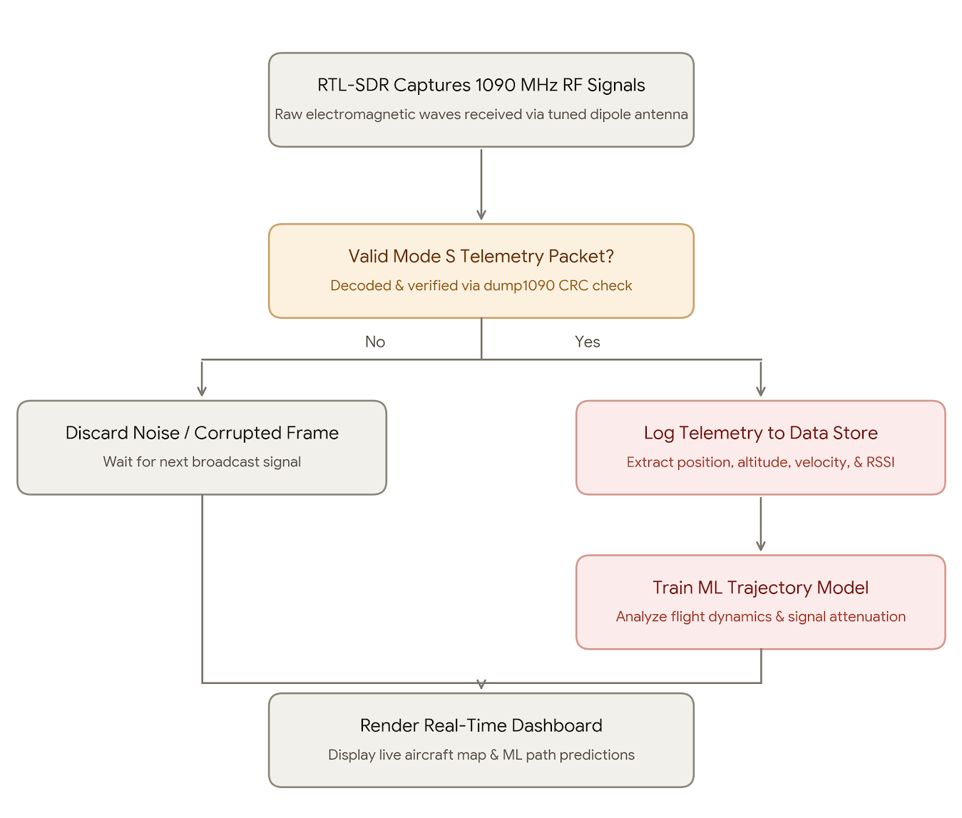
Core Goal:
Capture raw 1090 MHz electromagnetic waves from commercial aircraft in real time using Software-Defined Radio (SDR).
Build an end-to-end Python processing and machine learning pipeline to analyze flight telemetry, signal attenuation, and trajectory patterns.
Advise to show more article, paper, patent you survey
Key point: paper survey ability, improvement result before and after, certificate
Science direct, 中華民國專利

Slide 37
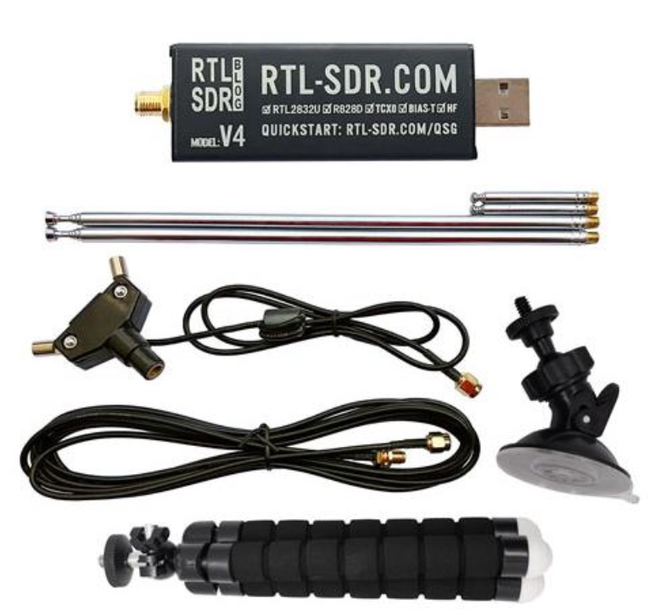
System Architecture & Hardware
RF Receiver:
RTL-SDR Blog V4 Dongle
Adjustable Dipole Antenna Base
  configures two telescopic arms
for balanced signal reception
Small Telescopic Antenna Elements
  Tuned specifically to the 1090 MHz wavelength
  approx 6.9cm quarter-wave length per side
Low-Loss SMA Extension Cable
  allows remote positioning of the antenna away
from USB port electromagnetic interference
Flexible Tripod & Suction Mounts
  Modular mounting hardware for stable window or outdoor placement during data collection.

Slide 38
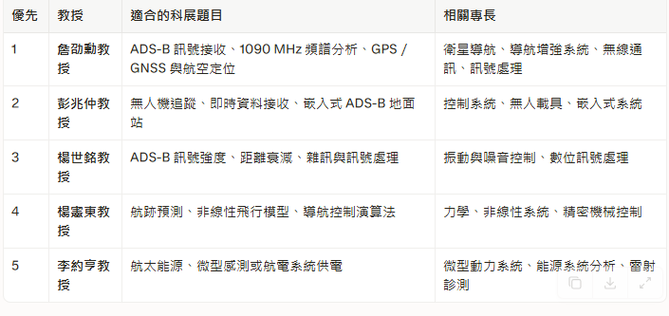
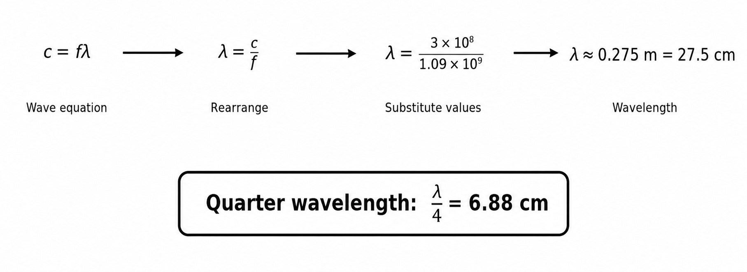
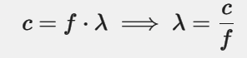
Hardware Strategy & Resonance Tuning
c = speed of light = 3 * 10^8 m/s
f = 1090 Mhz = 1.09 * 10^9 Hz
λ = physical length of one complete electromagnetic wave cycle in space
Using the wave equation:
  A
*Total Antenna Length (13.76 cm): Divide the full 27.52 cm radio wave in half (λ/2) to get the total end-to-end size needed for the antenna system to resonate.(half wave is better than full wave)
Each Telescopic Arm (6.88 cm): Divide that total length in half again (λ/4) to find the exact distance you need to pull out each of the two individual metal rods.
Half wave absorbs more signal

Slide 39
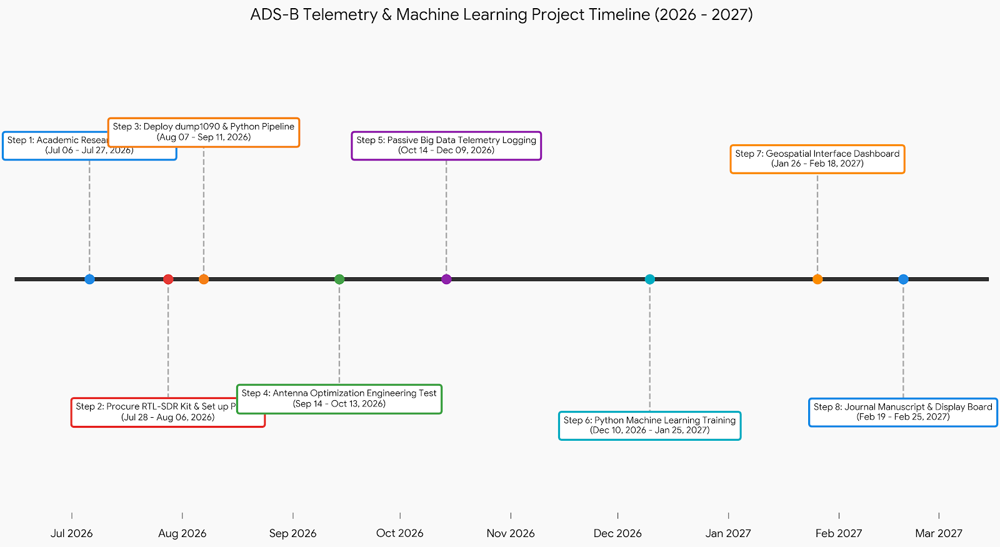
Project Timeline & Current Progress
Currently waiting for parts to arrive.

